Slide 1

World Athletics Rule Changes 2023

Slide 2
How are World Athletics Rule changes made?
The World Athletics Council is responsible for reviewing rule change proposals from member federations.
Changes can be described as being in one of several “groups”:
  wording changes due to the concept of World Rankings Competitions
  conversion of all generic textual references to gender so that all such references are gender neutral
  new terminology such as Short Track and World Athletics Referee
  standard editorial changes to correct grammar, punctuation and mistakes in rule references from one rule to another
  some standardisation of wording such as Qualification (instead of Qualifying)
  several substantive rule changes that are explained on the following slides

Slide 3
Changes to Competition Rules (CR)
CR20 – Umpire Reports – Green Text
  Clarification to reduce the number of DQs that should be DNF
  Applies where athlete has obviously stopped racing even if eventually reaching the finish line
CR18
  A large part of what was CR18, has been relocated to Technical Rule 7
  Note has been added to CR18.5 stating Referee’s ability to warn or exclude an athlete under TR7.1
CR25.4
  Addition of an abbreviation/symbol
  Advanced to the next round by draw qD

Slide 4
Changes to Technical Rules (TR)
Highlights of the key changes relating to stadium-based competitions follow

Slide 5
TR4.3 – Simultaneous Entries
Existing Rule:
If an athlete is simultaneously competing in both track and field event at same time, or two field events, the referee may allow an athlete to take trial out of order for one round only.
Clarification:
If the athlete is not present for the trial during the round in which the change of order is agreed, it should be recorded as a pass once the time has elapsed.
In subsequent rounds, if athlete misses a trial, it should be recorded as a a failure once the time has elapsed.
Part I - General

Slide 6
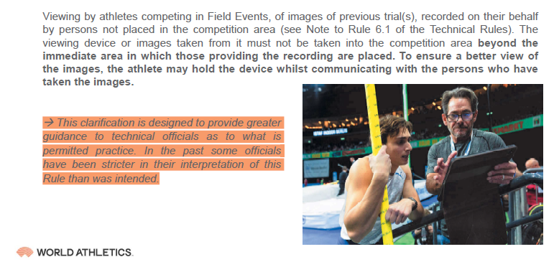
TR6.4.5 – Viewing of Images
Existing Rule (no change):
Athletes in field events may view images of trials but devices must not be taken to competition area.
Clarification:
The athlete may hold the device whilst communicating with the persons who have taken the images
Part I - General

Slide 7
TR7 – Warnings and Disqualifications
Clarification:
There has been a substantial change to TR7 with many of the sections changing number.
It is worth reviewing this rule in full to be prepared for stating rule numbers with any warnings or disqualifications issued.
There is a useful table of rules applicable to disqualifications on the World Athletics website under “Manuals & Guidelines” here:
Technical Information | Official Documents (worldathletics.org)
Part I - General

Slide 8
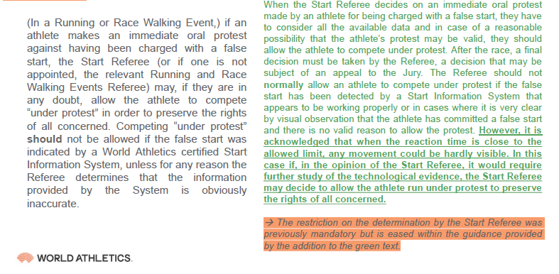
TR8.4.1 – Protests at the Start
Rule Change:
If an athlete false starts and is disqualified, under certain circumstances, the athlete can be allowed to compete under protest.
This is if there is a borderline case of movement close to the reaction time limit.
Part I - General

Slide 9
TR8.4.1 & TR8.4.2 – Protests at the Start
Rule Change:
Addition of a red and white (diagonally halved) card
to be used for any athlete running under protest.
Any athlete making a protest after a race is run relating to a failure to recall or abort a start must have made a bona fide effort in the race.
Part I - General

Slide 10
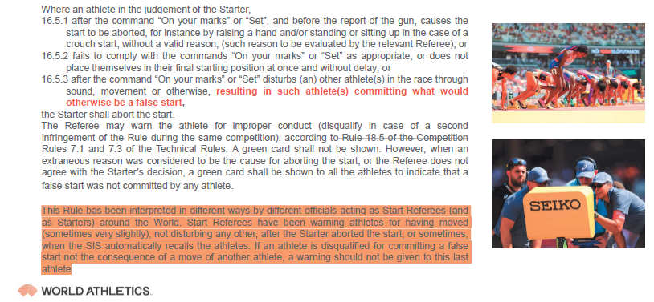
TR16.5.3 – Disturbing the Start
Clarification:
If an athlete shifts slightly but is not the cause of a false start or disturbance of another athlete, the athlete should not be issued a warning.
Part II - Track

Slide 11
TR19.19 – Photo Finish Operation
Clarification:
If a Start Referee is appointed, they should attend the Zero Control Test but no other referee is required
If no Start Referee is not appointed, the relevant Running or Race Walking Events Referee should attend the ZCT
Part II - Track

Slide 12
TR20.2.1 – Middle Distance Qualification
Rule Change:
To remove the perceived unfair advantage of later middle distance heats knowing the times from earlier heats, there are now ONLY automatic qualifiers
Regulations applicable to individual competitions can allow for any vacant positions due to withdrawals to be filled by the next ranked athletes from the previous round
Part II - Track

Slide 13
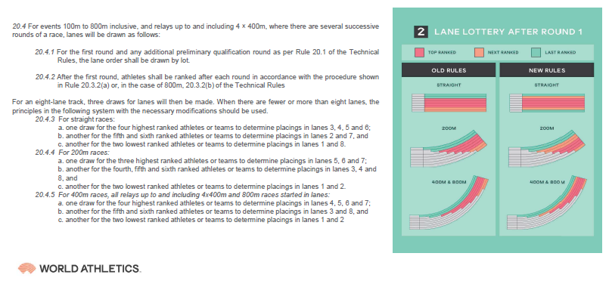
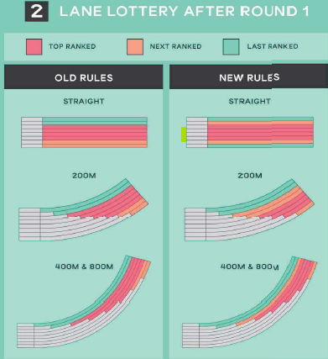
TR20.4 – Track Draws – “Preferred” Lanes
Rule Change:
Allocation of lanes after round 1 has changed to take into account preferences for different lanes in different races
Part II - Track

Slide 14
TR24.7 – Passing of the Baton?
Rule Addition:
Inclusion of the applicability of rule 17.3.2 (lane infringement on the straight)
Part II - Track

Slide 15
TR24.11
Rule Change:
Relay team declarations no longer need to be submitted an hour in advance.
Relay team declarations now required no later than the published first call time for each heat
Part II - Track

Slide 16
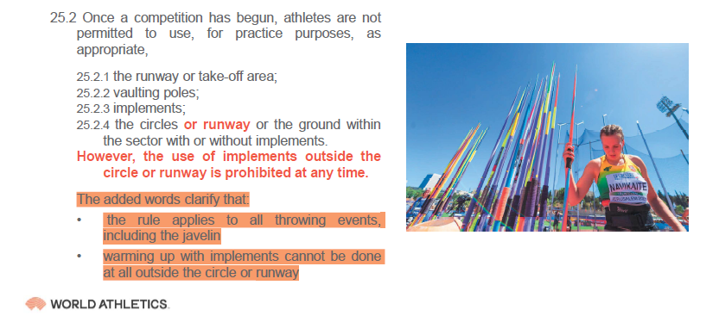
TR25.2 – Practice Trials for Field Events
Safety Clarification:
Athletes are not permitted to use throwing implements outside of the circle or runway for any purpose at any time (including during warm-up)
Part III - Field

Slide 17
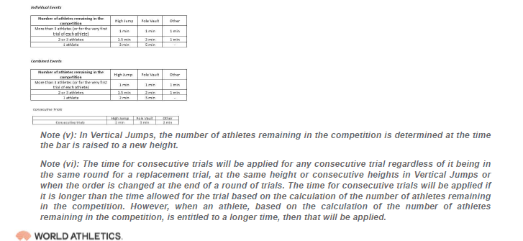
TR25.17 – Clarification: Timing for Competition Trials
Clarification:
For Vertical Jumps: the number of athletes remaining in the competition is determined at the time the bar is raised to a new height.
Consecutive trial time applied regardless of:
it being in same round for replacement trial
at the same height or consecutive heights in VJ
when order changed at end of round of trials
The longer of the time is always applied, i.e.
consecutive > no. athletes remaining = use consecutive
no. athletes remaining > consecutive = use no. athletes remaining
Part III - Field

Slide 18
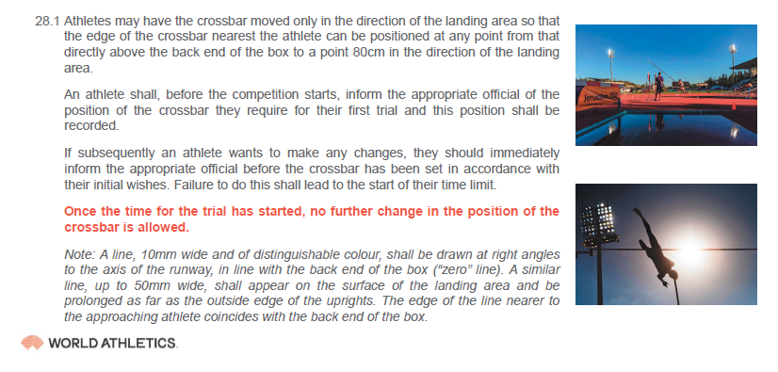
TR28.1 – Pole Vault: Movement of the Crossbar
Clarification:
Pole Vault - Once the time for the trial has started, no further change in the position of the crossbar is allowed
Part III - Field

Slide 19
TR28.11 – Use of Other Athletes’ Vaulting Poles
Clarification:
If an athlete attempts to use another athlete’s pole without permission:
If the judge notices before the attempt and points it out to the athlete
  Trial is valid if the athlete complies, providing no other rules are broken
  Trial is a failure If the athlete fails to comply
If it is not noticed until after the attempt
  Trial is a failure
Part III - Field

Slide 20
TR29.5 – Construction of Take-Off Boards
Rule Addition:
Take-off boards can now be made from a single board 0.3m wide.
0.2m white section
0.1m contrasting colour section
i.e. take-off board and blanking board can now be one piece
Part III - Field

Slide 21
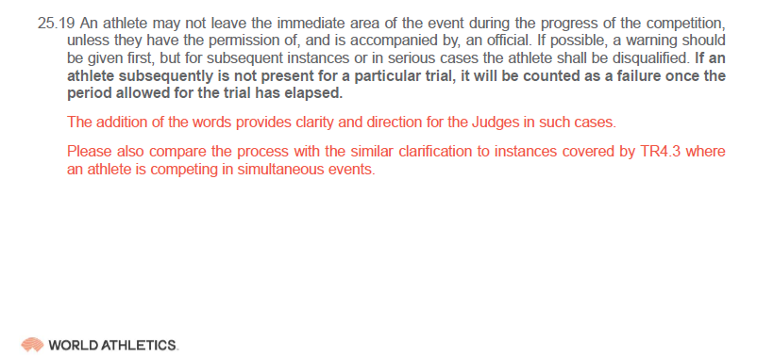
TR29.19 – Absence During Competition
Clarification:
If an athlete leaves the competition area without permission, they should be warned for the first offence and disqualified for subsequent offences.
If an athlete is not present for a trial, it will be a failure once the time has elapsed.
Part III - Field

Slide 22
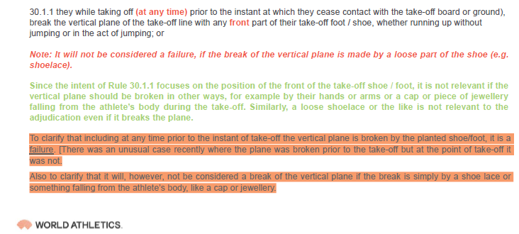
TR30.1.1 – Clarification: Take-off in Horizontal Jumps
Clarification:
It will be a failure if:
While taking off, prior to the instant they cease contact with the take-off board, break the vertical plane of the take-off line with any front part of foot / shoe.
It will not be a failure if:
The break of the plane is from a shoelace or something falling from an athlete's body (e.g. cap or jewellery)
Part III - Field

Slide 23
TR31.2
Clarification:
“Sleeping” leg part of the rule applies to all phases, not just the jump phase
Part III - Field

Slide 24
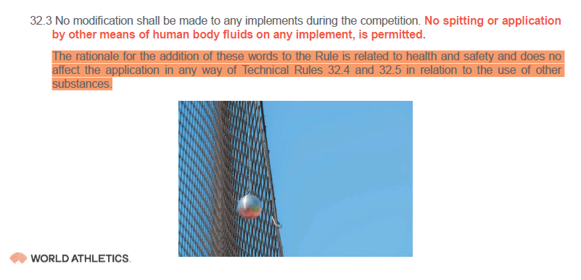
TR32.3
Addition to Existing Rule
No spitting or application by other means of human bodily fluids on any throws implement is permitted
Part III - Field

Slide 25
TR32.4 – Assistance in Throwing Events
Clarification:
If an athlete attempts to use assistance as defined in TR32.4:
If the judge notices before the attempt and points it out to the athlete
  Trial is valid if the athlete complies, providing no other rules are broken
  Trial is a failure If the athlete fails to comply
If it is not noticed until after the attempt
  Trial is a failure
Part III - Field

Slide 26
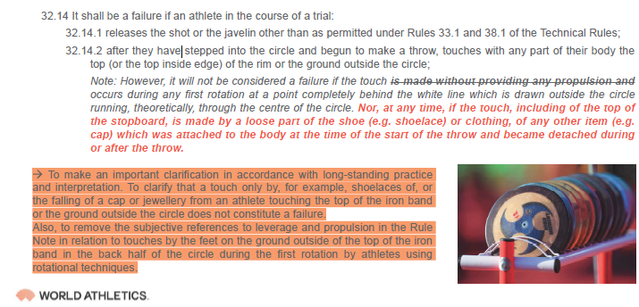
TR32.14.2 – Clarifications: Throwing Events
Clarification:
It will not be a failure if:
At the rear of the circle, the touch (top or rim or ground outside) occurs during the first rotation (removal of reference to providing propulsion)
It will not be a failure if:
A touch of the stopboard is made by loose part of shoe (eg shoelace) or clothing which was attached to the body at the start of the throw
Part III - Field

Slide 27
TR39.8.5 – Combined Events Lane Draws
Change to Rule
For 200m and 400m Combined Events races the new lane draws should be applied
Part IV - Combined Events Competitions

Slide 28
“Short Track” & Technical Rule 45.1
Change to Rule
Indoor competitions will be referred to as Short Track
Track layouts will be:
400m Standard Oval Track
200m Standard Oval Track (Short Track)
Indoor World Records are discontinued
Indoor events that were “performance different” will have a Short Track event record (sh)
This is predominately any race with a bend and combined events (pentathlon (women), heptathlon (men))
Part V - 200m Standard Oval Track Stadium (Short Track) Competitions

Slide 29
Is that everything?
No…
  Covered key selection of substantive rule changes only
  European Athletics/World Athletics released a slide pack of the full substantive World Athletics rules – available from Zoe
Planning ahead for manufacturers…
  New shoe rules to come in force from 1st November 2024
  700g javelin specification will be changed from 1st April 2025
Full list of World Athletics Rule Changes can be found on the World Athletics website but many are minor text changes.
And the World Athletics Council meets every 3 months so watch this space!

Slide 30
What about other governing bodies?
UK Athletics will issue a new rule book effective April 2024
  Incorporating World Athletics changes
  Additional changes relevant to UK competition
World Para Athletics have issued a new rule book effective March 2024

Slide 31

Useful Rule Resources
UK Athletics Rule Information (Rule Book & Changes):
  Rules of Competition | UK Athletics
    (note, the 2024 rule book has not yet been released)
World Athletics Rule Information:
  Most updated rule book: Book of Rules | Official Documents (worldathletics.org)
  Full text of rule changes: Technical Information | Official Documents (worldathletics.org)
World Para Athletics Rule Information:
  Athletics Rules and Regulations | World Para Athletics (paralympic.org)

